Slide 1
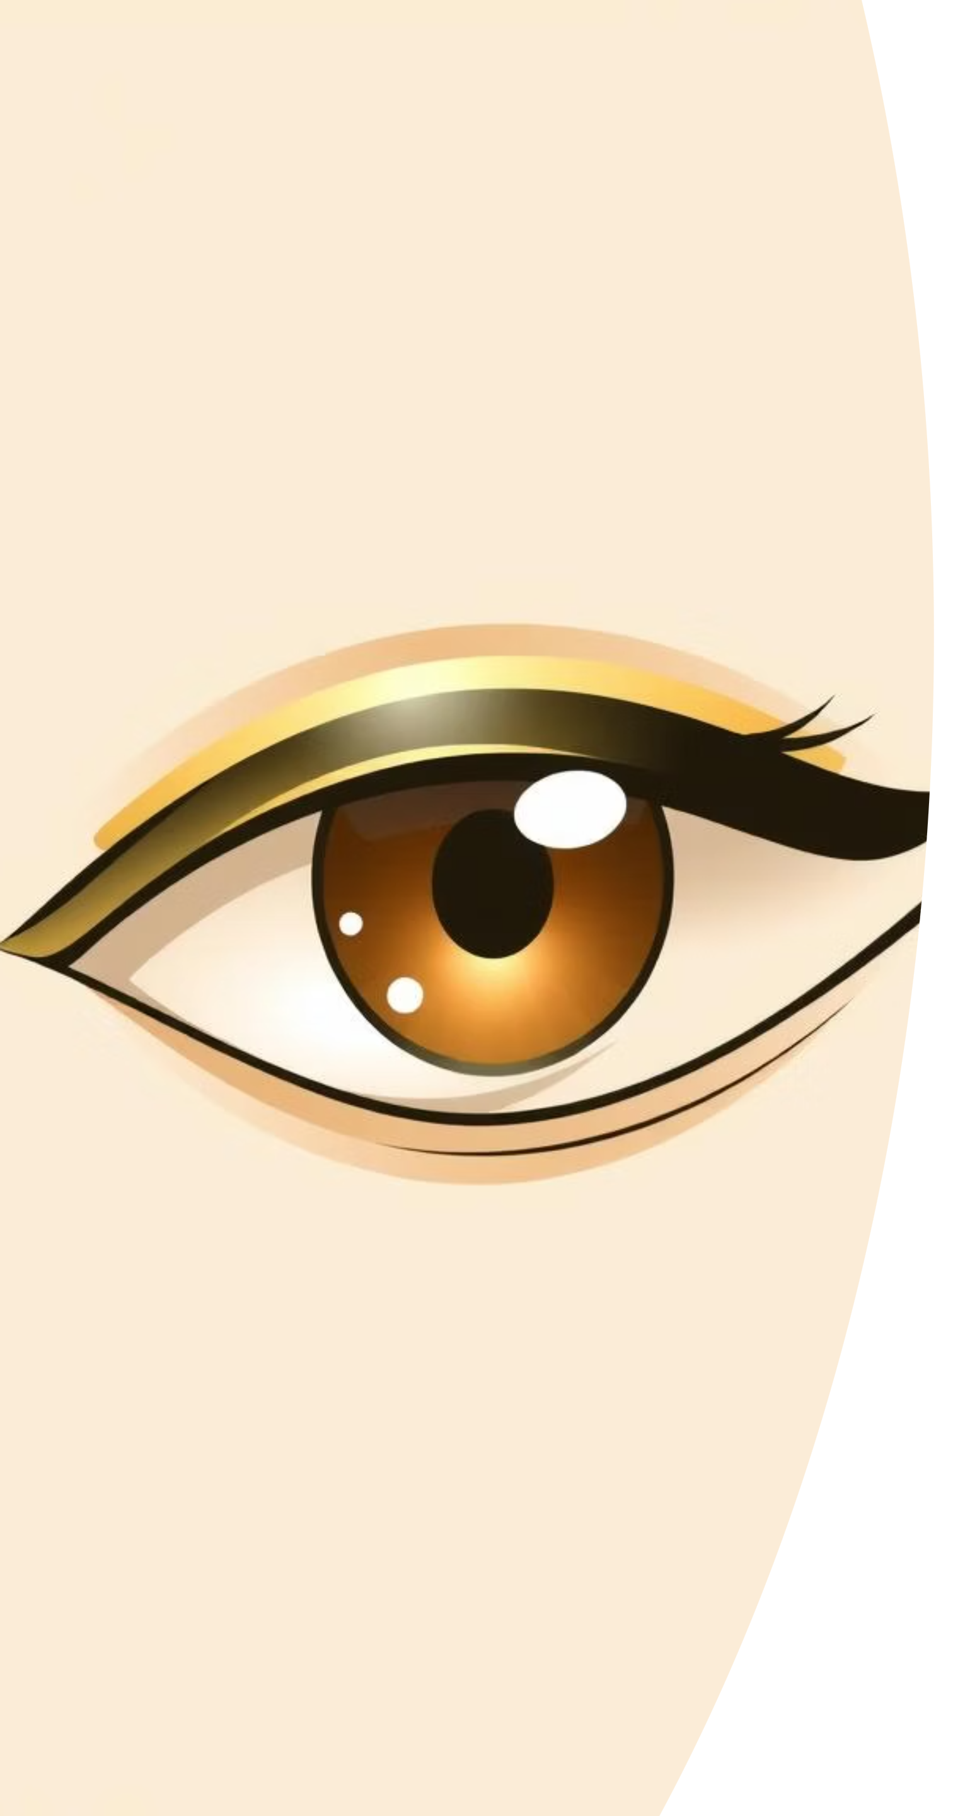
GazeFocus
The AI-Powered Attention & Posture Coach
Project Developer: Shubham
GitHub : Github.com/shubhamp1028/FrameFocus

Slide 2
The Modern Focus Dilemma
Rising Distractions
Remote Everything
Notifications, social media, multitasking
"Zoom fatigue," decreased productivity
Poor Ergonomics
Flawed Solutions
Slouching, long-term strain, fatigue
Invasive monitoring, passive timers
How might we measure and improve focus in a passive, privacy-conscious way?

Slide 3



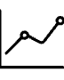
Introducing GazeFocus
An intelligent desktop application using webcam and computer vision to:
Quantify Focus
Coach Posture
Deliver Insights
Real-time "Focus Score" based on screen presence.
Gentle, real-time alerts for slouching or leaning.
Tracks productive trends without invasive monitoring.
Core Principle: Passive Sensing.
We infer your state from gaze and posture, not keystrokes or screen content.

Slide 4
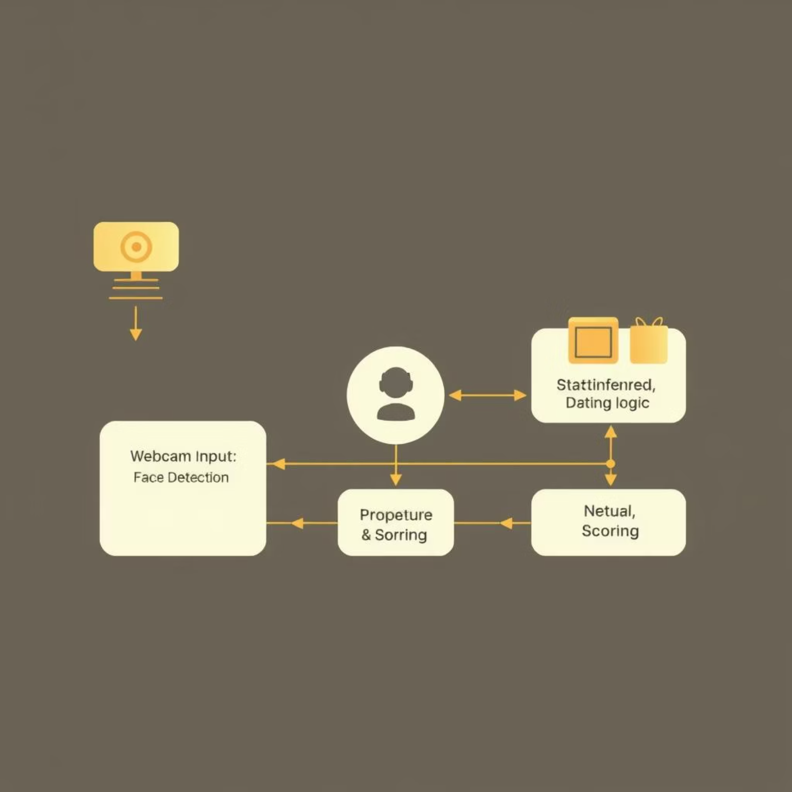
Under the Hood: Computer Vision & Logic
Input
Raw webcam feed.
Processing
Face Detection: OpenCV DNN (WIDER FACE dataset)
State Inference: Custom logic analyzes face position.
Output & Action
Presence: Timer runs/pauses.
Posture: Alert triggered.
Scoring: Rules-based algorithm.

Slide 5
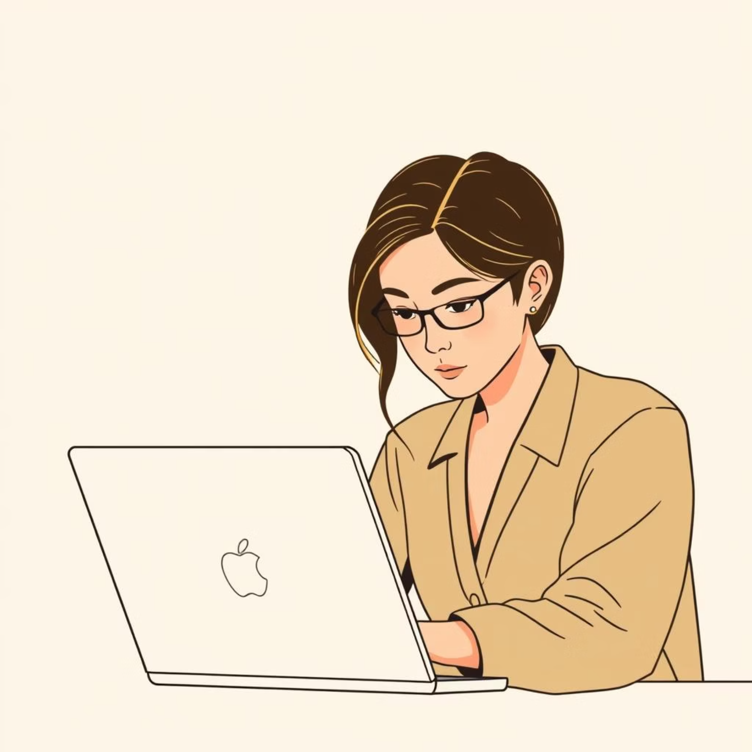
Use Case: The Deep Work Assistant
For: Freelancers, developers, writers, students.
Value: Gamified productivity challenge.
How it works:
Runs quietly in background.
Focus Score rises with uninterrupted work.
Posture nudges prevent fatigue.
Goal: "Beat your high score" from yesterday.

Slide 6

Use Case: The Engagement Analytics Tool
For: Students, Teachers, Educational Institutions.
Value: Objective feedback on learning engagement.
How it works:
For Students: Pauses lecture if attention drifts.
For Teachers: (Anonymized) class engagement data.
For Proctoring: Flags unusual attention patterns during exams.

Slide 7
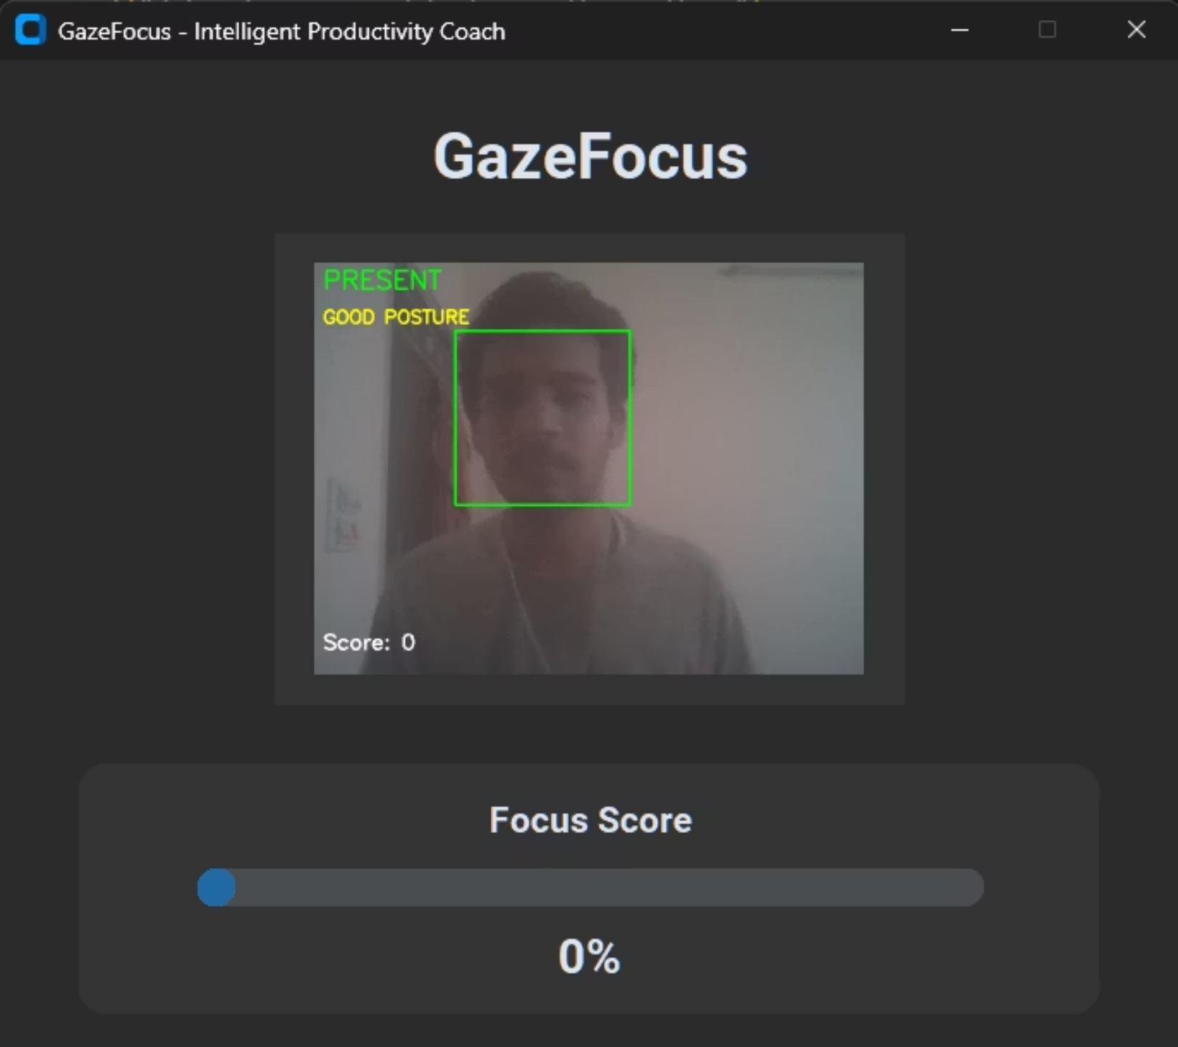
Use Case: The Privacy-Conscious Productivity Dashboard
For: Remote Teams, Managers, HR.
Value: Measures team productivity & wellness without invasive spyware.
How it works:
Aggregated, anonymous data on team focus patterns.
Identifies burnout risks.
Answers: "Enough focus time between meetings?"
Crucially: Protects individual privacy, provides team insights.

Slide 8
Building a Robust Application
Architecture
Key Challenges Overcome
Language: Python
Real-time Performance: Efficient CPU optimization.
Libraries: OpenCV, CustomTkinter, NumPy, PIL
Lighting & Robustness: Tuned for varying conditions.
Design: Multi-threaded (GUI + OpenCV) for smooth UX.
Threading: Safe data sharing, no crashes.

Slide 9
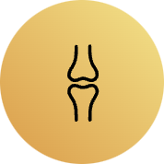
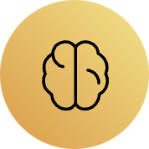
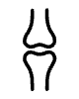


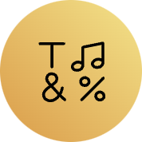

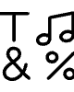
What's Next for GazeFocus?
Advanced Pose Estimation
ML-Powered Insights
MediaPipe for full-body posture analysis.
Predict optimal work/break schedules.
Cross-Platform Sync
API for Developers
Web dashboard for focus analytics.
Allow other apps to query focus status.

Slide 10
Conclusion
GazeFocus proves that powerful technology can be simple and respectful.
For the User
For Organizations
For Developers
Non-invasive coach building better work habits and wellness.
Ethical, privacy-focused lens into productivity and engagement.
Practical, impactful computer vision solving real problems.

